Slide 1
Rhythmic Overtones
Alex Allmont
Motives behind LEGO pieces and ongoing research

Slide 2
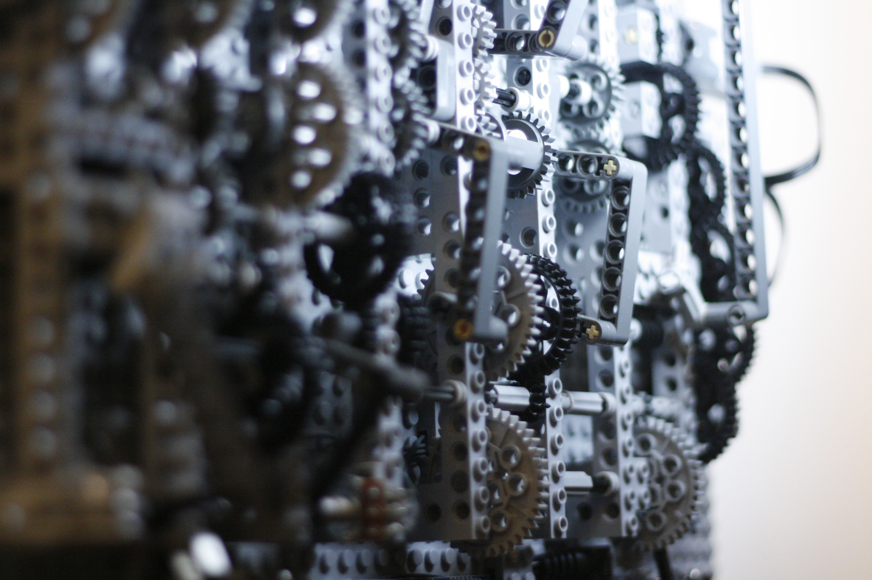
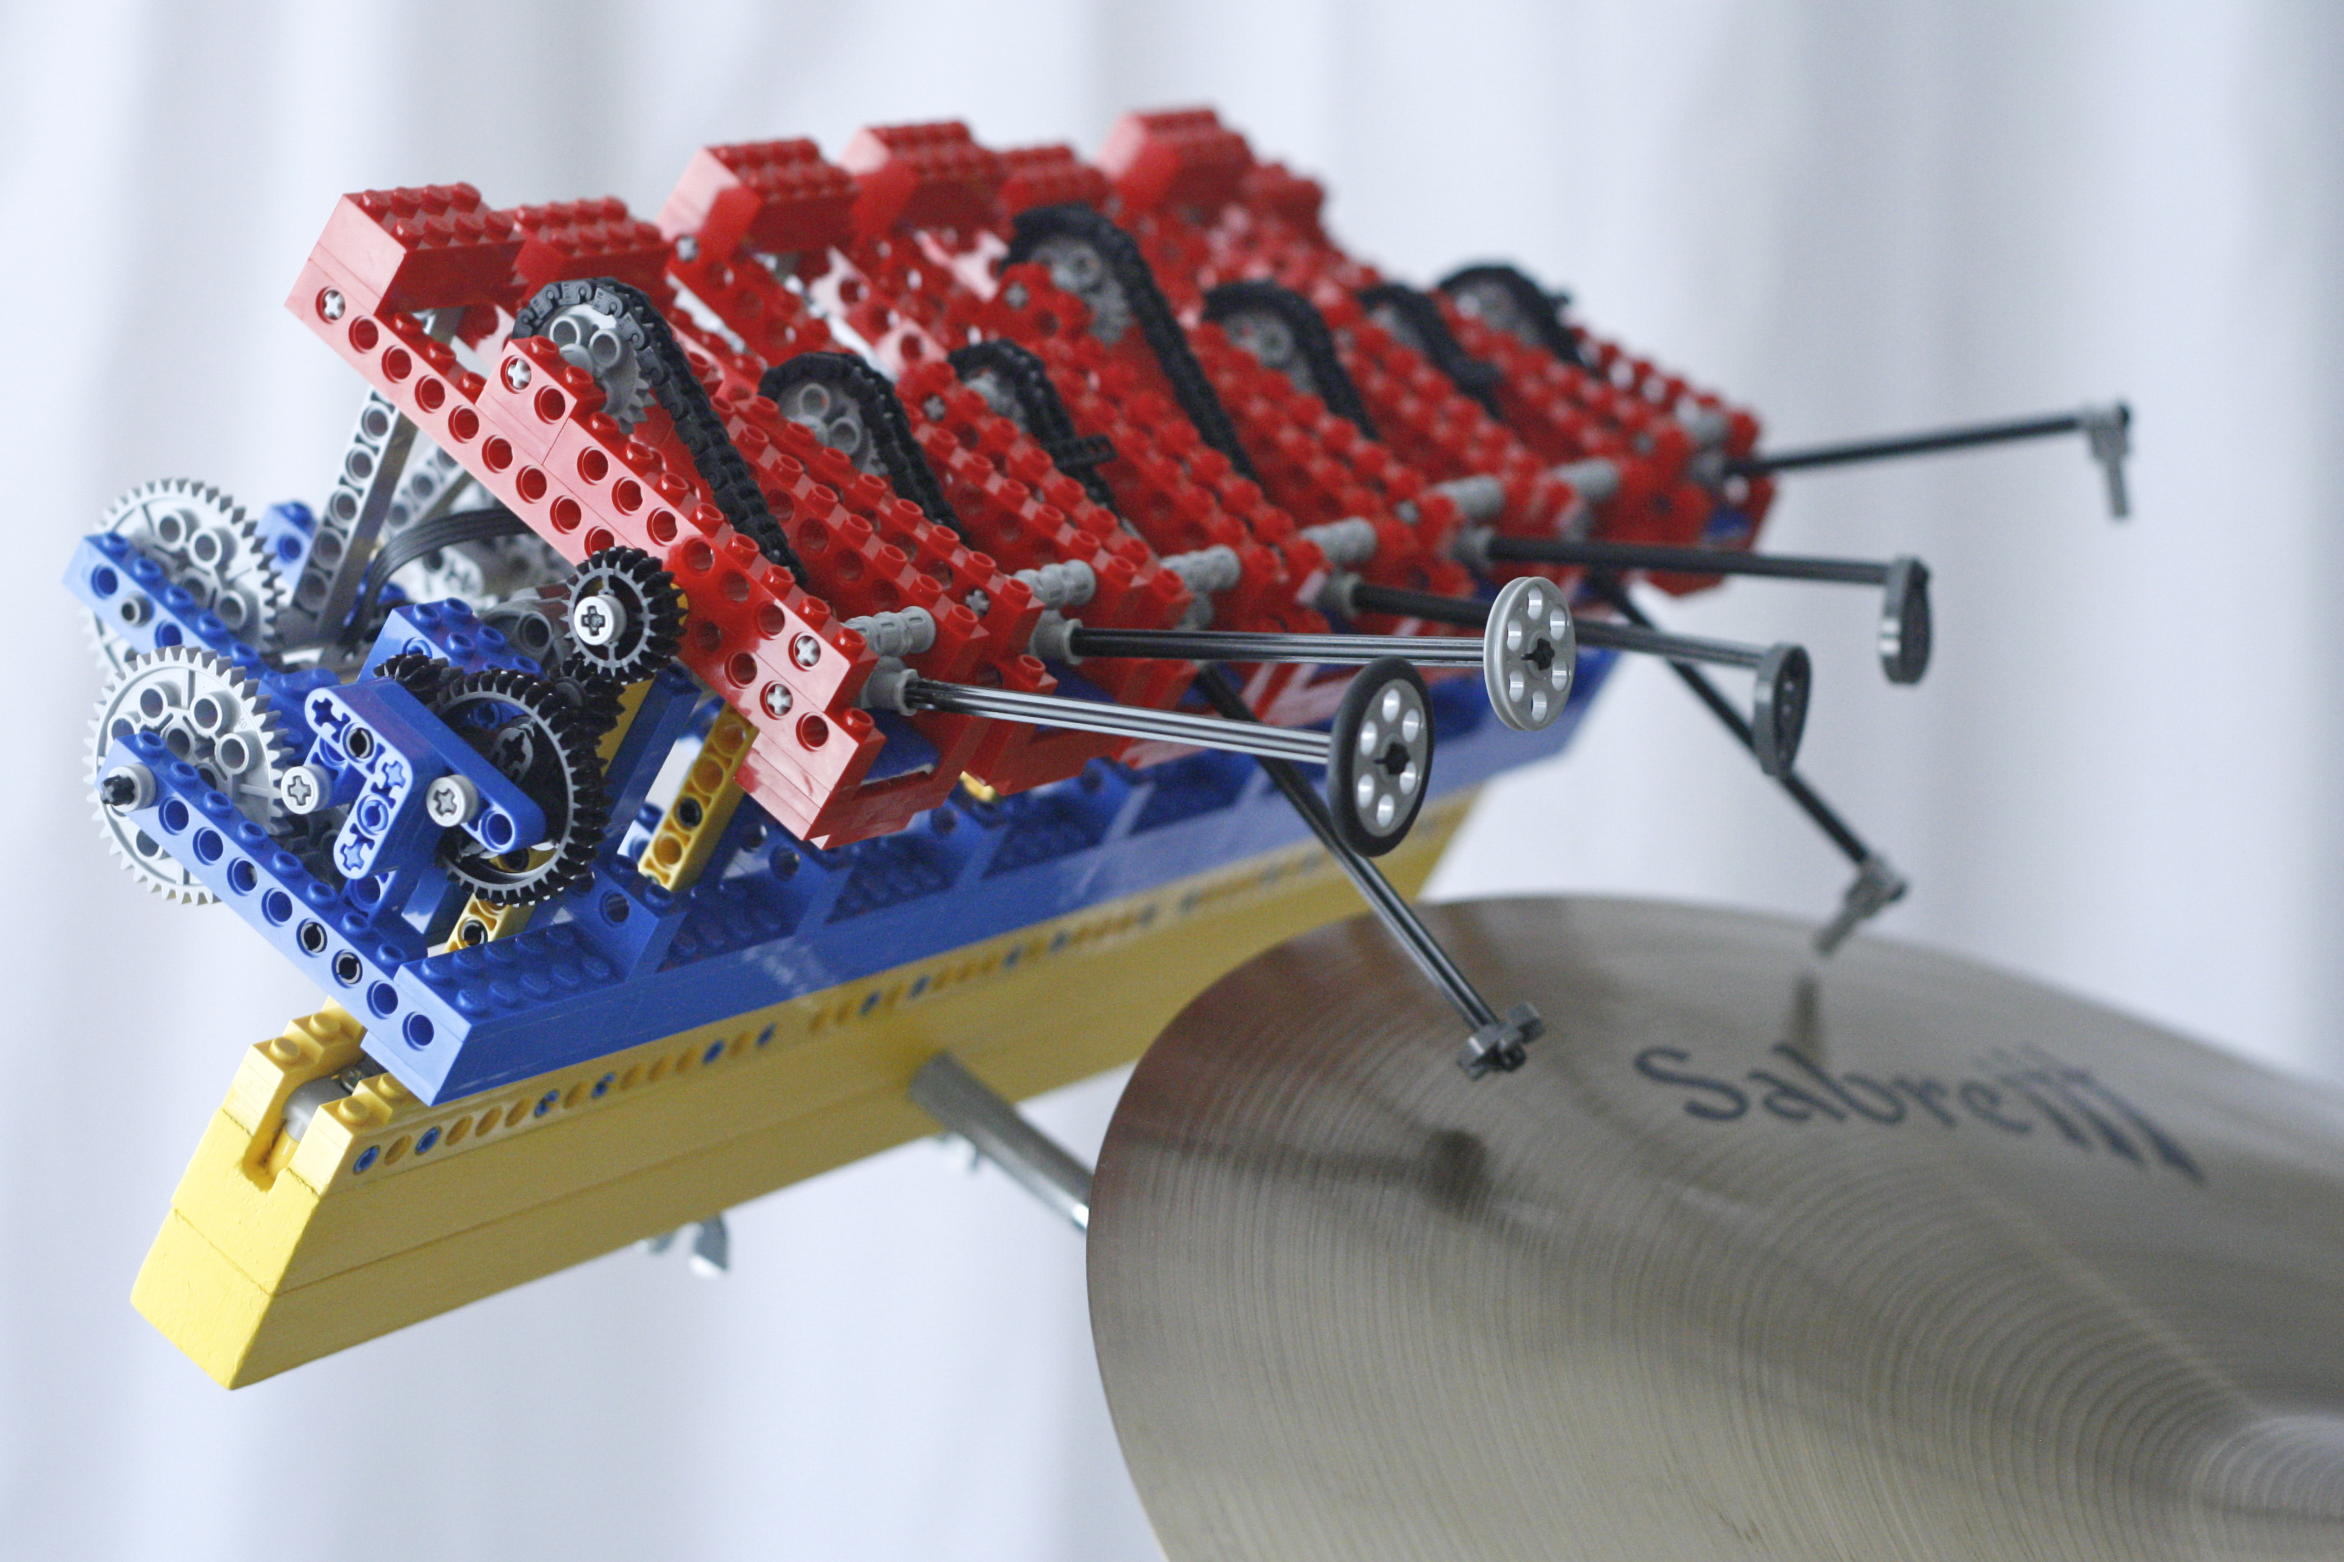
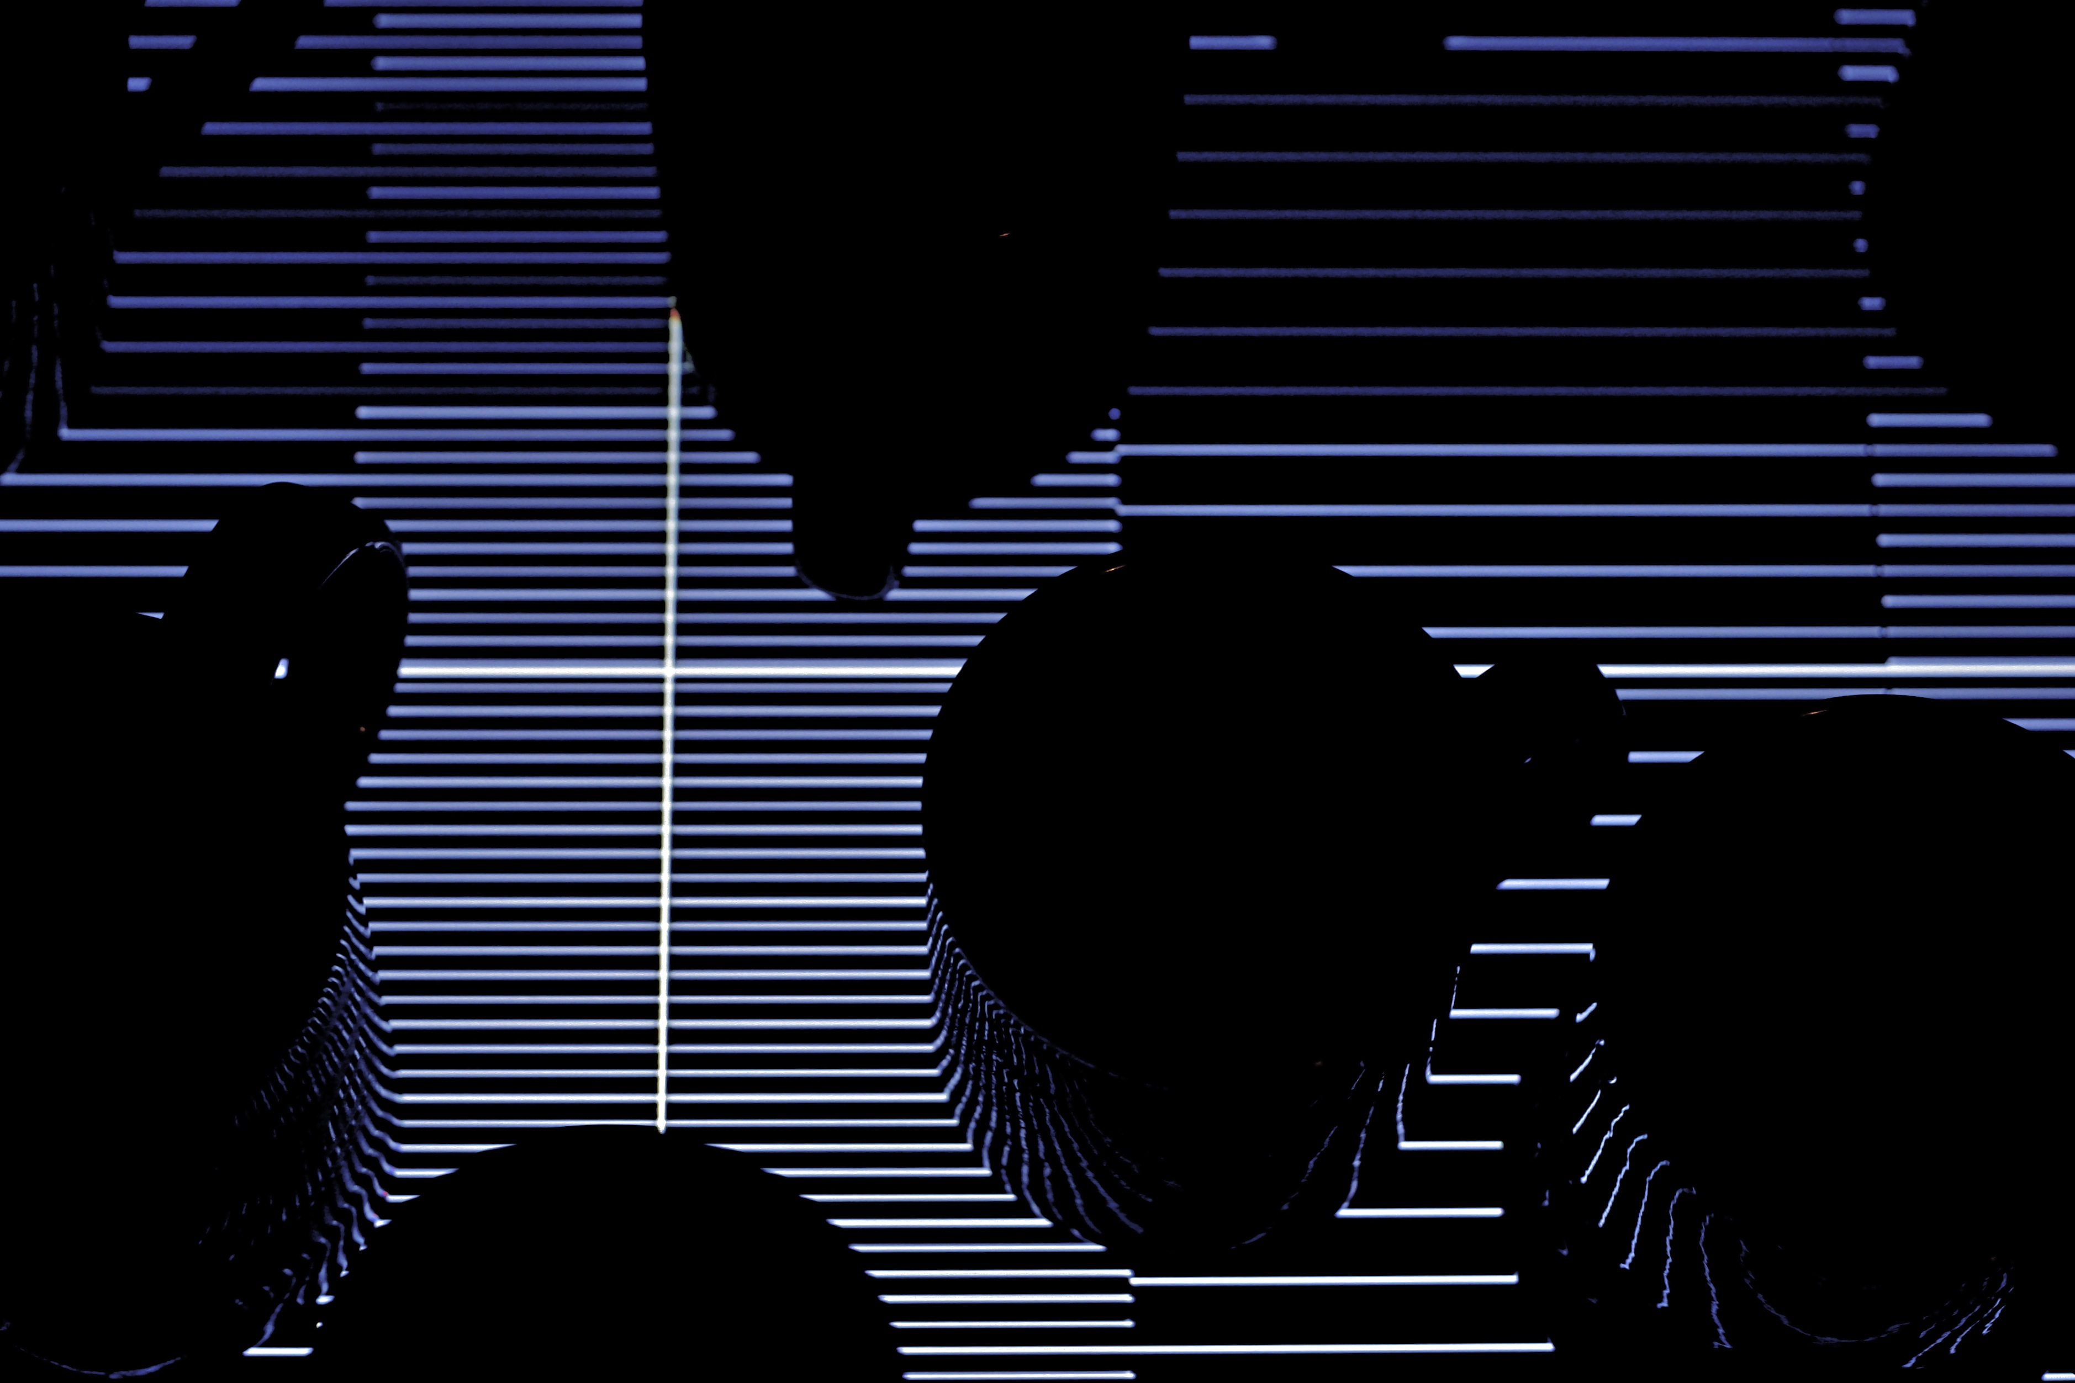
Backstory
Generative musical sculptures, BEAM, Kinetica
All Work and No Play Too Much Coffee Clash of the Fractions
Full time coder and part time practice-based PhD – interacting and engaging with rhythm

Slide 3
10 minute dash
MA
ideas behind practice, developing practice
PhD
questions, shaping ideas, aims
Demo
In progress rhythmic ideas

Slide 4
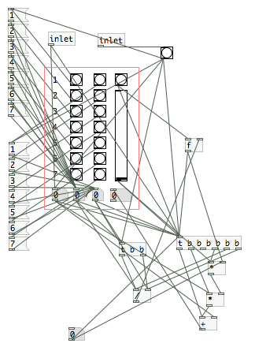
MA – developing practice
Honing in on core fascinations
Slowing - traffic calming, walking
Emergence - synchronicity, perception
Constraints - forcing alternate thought process
Exploratory sound work
Noise ➔ beat frequencies
Group percussion
Clapping
7 Breakfasts

Slide 5
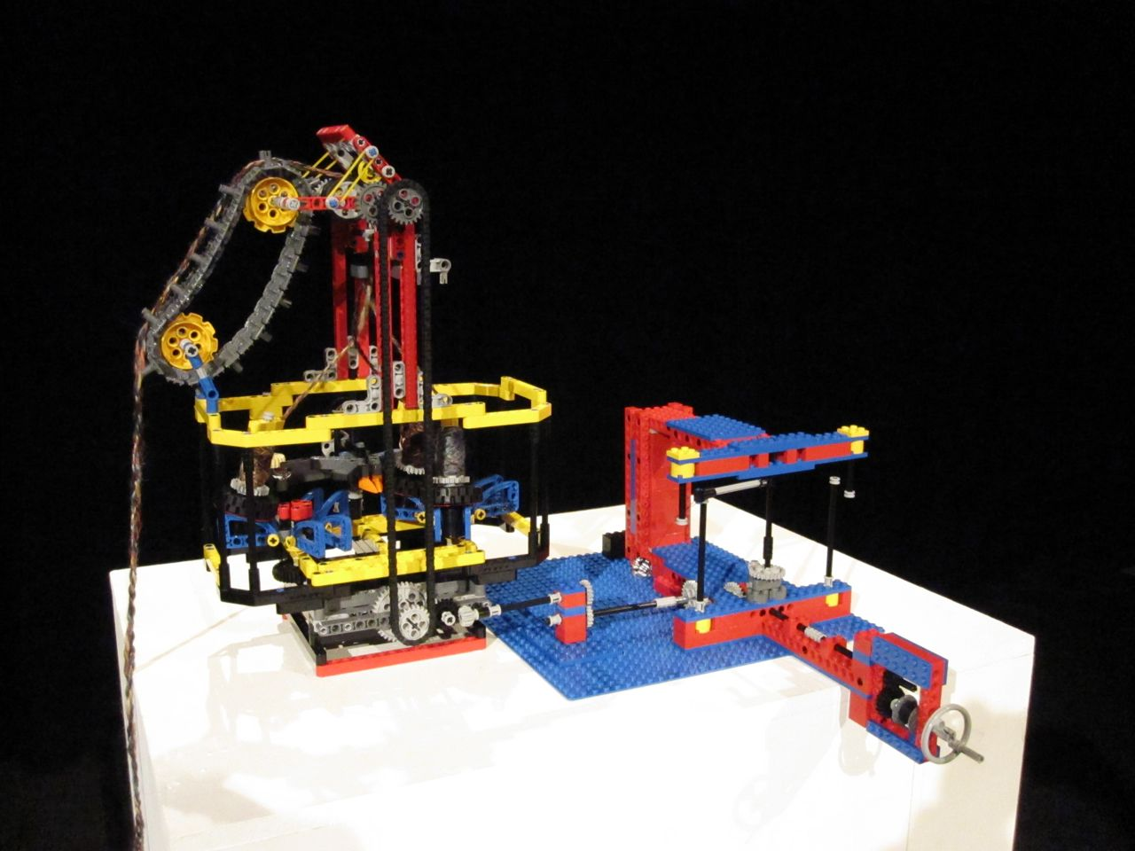
MA – development pieces
LEGO work (see vimeo)
Missing Link
Music of the Gears
Plaiting machine
A rushed summary
practice focuses on sustaining apparent moments of emergence though constraints that slow or focus attention.

Slide 6
PhD – questions
Is there a connection between how we perceive harmonic intervals and polyrhythmic equivalents?
e.g. perfect 5th vs 3:2 polyrhythm
explore more complex ratios in rhythm
Can the meditation of phased performance be promoted to improvisation?
Reich, gamelan, traditional drumming ➔ ways of indirectly interacting with rhythm

Slide 7
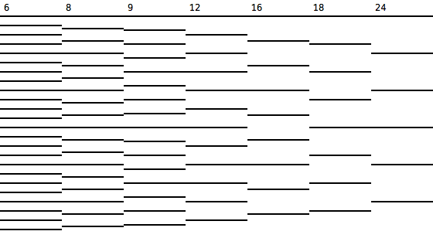
PhD - rhythmic ‘intervals’
Tempo equivalents of perfect 4th, 5th and octave:
1:1 4:3 3:2 2:1 8:3 6:2 4:1
these familiar jazz/latin polyrhyhms as starting point

Slide 8
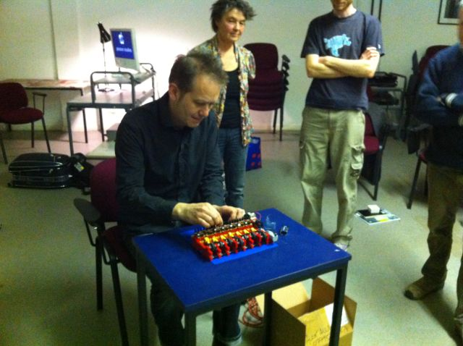
PhD – intervals in practice
Pythagorean Polyrhythmic Piano
interact with intervals
come and try it!
Other installations
Ride with Me
Clash of the Fractions
Too Much Coffee

Slide 9
PhD – sustaining attention
‘Tipping point’
Joke: setup ➔ punchline
Nature: noise ➔ stability
Music: tension ➔ release
Constantly balancing
Syncopation: moving rhythm
Phasing: Reich
Play: complex / simple

Slide 10
PhD – revised aims
Develop drum equivalents of overtones / timbre, shaping sounds
Tuvian throat singing (playing with resonance)
analogue synthesizers (e.g. drum equivalent of Josh Wink twiddling, dubstep wobbles?)
Pushing rhythmic palette:
Pythagorean / whole / tempered / dissonance
In summary: indirect, playful rhythmic interactions for both audience and performer

Slide 11
Demo
Polyrhythmic group jam prototype

